Slide 1
🩺 Image Classification Using CNN: Software vs Hardware Comparison ( Lung Cancer data)
FPGA PROJECT
Lung cancer remains one of the leading causes of cancer-related deaths worldwide. Early and accurate diagnosis is critical for improving patient survival rates. With the growing availability of CT scan data and advancements in machine learning, automated image classification systems have the potential to assist radiologists in identifying cancerous patterns more effectively.
This project explores the development of an image classifier by comparing the classification performance of both software-based and hardware-accelerated implementations. The goal is to evaluate and apply the most effective method on a lung cancer dataset, focusing on accuracy, speed, and efficiency.
Prepared by
Jazzmin Poitier
Maiva Ndjiakou
Course: Advanced Digital Design
University of Virginia
1
May 2025

Slide 2

Project goals
Objectives
Train a CNN for binary classification of lung cancer (benign vs. malignant).
Compare classification speed and accuracy on CPU vs. FPGA.
Evaluate FPGA resource usage and performance bottlenecks.
Requirement Analysis
Dataset: Kaggle lung cancer CT image dataset.
Software Stack: PyTorch, NumPy, OpenCV, Python 327 (for training).
Hardware Platform: PYNQ-Z1 FPGA board.
BNN Framework: BNN-PYNQ (for feature extraction & acceleration).
Time Constraints: Limited project timeframe necessitated using existing frameworks instead of full custom RTL.
Prepared for
FPGA PROJECT
2
Notes:
In the early stages of our project, our primary goal was to implement an accurate lung cancer image classification system, with a focus on comparing software-based processing to hardware acceleration using an FPGA board. The overall objective was to determine which implementation—software or hardware—provides the most efficient balance between accuracy and processing speed for medical image classification.
The requirement for our Analysis was :
Dataset: Kaggle lung cancer CT image dataset.
Software Stack: PyTorch, NumPy, OpenCV, Python 327 (for training).
Hardware Platform: PYNQ-Z1 FPGA board.
We choose to use PYNQ-Z1 because of its potential for low-latency inference using hardware-accelerated binary neural networks (BNNs). Unlike software execution, FPGA-based inference can be parallelized and optimized at the hardware level, making it highly efficient for embedded or edge AI applications like medical diagnostics.
BNN Framework: BNN-PYNQ (for feature extraction & acceleration).
While following the project steps we decided to use BNN-PYNQ framework, which abstracts away the complexity of HDL development by providing Python-accessible overlays. This allowed us to focus on integrating the classifier with real medical data rather than writing RTL from scratch.
Time Constraints: Limited project timeframe necessitated using existing frameworks instead of full custom RTL.

Slide 3
System Design & Design Exploration Path
Approach | Description | Outcome
Custom Verilog Design | Initially considered implementing the CNN from scratch in Verilog/VHDL | Rejected due to time constraints and complexity
DNNWeaver 2.0 | Tried using the DNNWeaver framework to automatically generate Verilog from a trained model | Faced issues with Python environment compatibility and insufficient documentation
BNN-PYNQ (Final Choice) | Binary Neural Network overlays available for PYNQ-Z1 using Python & Jupyter | Chosen for rapid development, working overlays, and simplified hardware interfacing
Why BNN-PYNQ?
Already integrated with PYNQ board
Offers ready-made overlays for CNN (CNV) and Fully Connected Networks (LFC)
Supports parameter loading and feature extraction using Python
Avoids the need for HDL programming
Enables us to focus on training + deployment + performance measurement
3
Notes:
our initial exploration with a Custom Verilog Design was guided by academic ambition—we wanted to gain hands-on experience implementing low-level FPGA logic for neural networks. However, the complexity of designing, verifying, and testing a custom CNN from scratch using hardware description languages proved impractical within our project timeline. We concluded that this path would be better suited for a long-term thesis or industry-level work.
Next, we pivoted to DNNWeaver 2.0, an open-source tool designed to bridge high-level deep learning models and low-level hardware synthesis. While DNNWeaver theoretically provided a way to convert Keras models to Verilog, we encountered several roadblocks. These included strict dependencies on outdated Python versions (e.g., Python 2.7), deprecated TensorFlow APIs, and limited community support. Despite setting up the recommended virtual environment and installing Vivado 2018.2, compilation errors and cryptic configuration mismatches persisted. We determined that investing further time in debugging this framework would not guarantee successful deployment within the project deadline.
Ultimately, we selected the BNN-PYNQ approach as our final implementation strategy. This framework provides a suite of pre-compiled BNN overlays optimized for the PYNQ-Z1 board, along with Jupyter Notebook-based control interfaces. Its design aligns with our project goals—rapid deployment, simplified debugging, and functional integration with Python scripts. Using BNN-PYNQ, we were able to shift our attention from toolchain configuration to meaningful experimentation with real medical image data.

Slide 4
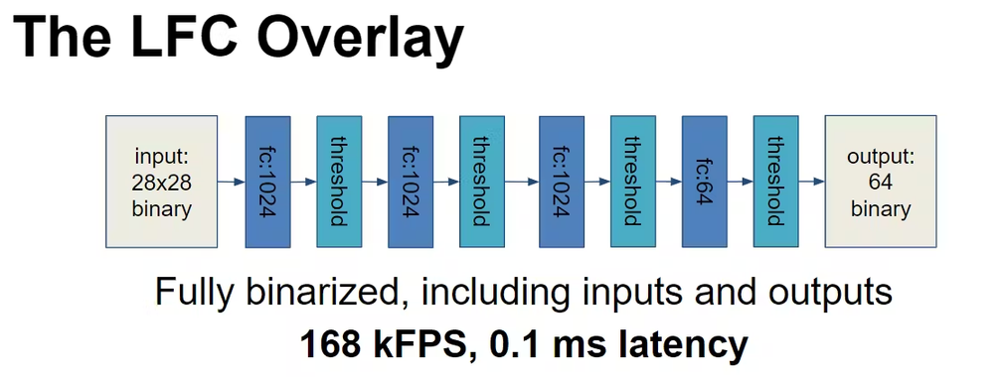
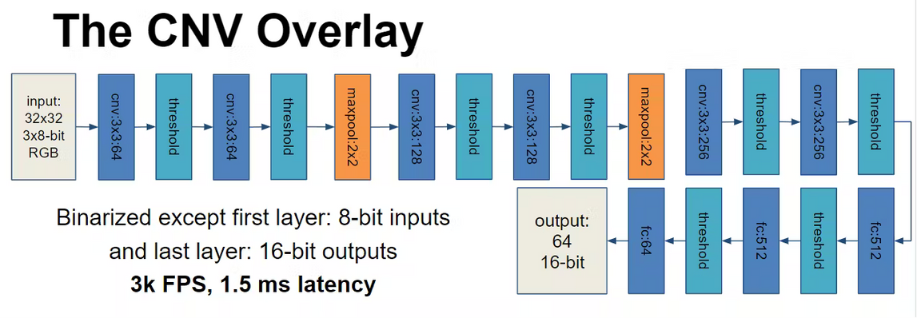
Architecture Selection and Data Preparation
Objective:
Verify and compare performance of pre-existing BNN models on the PYNQ-Z1 board
Evaluate software vs. hardware classification based on accuracy, processing time, and input data compatibility
Procedure:
Cloned the BNN-PYNQ GitHub repository
In this directory you will see several notebooks. These notebooks use one of two overlays
LFC - Fully Connected network designed for black and white operations on a 28 by 28 input
CNV - Convolution network designed for RGB operations 32 by 32 input
The structures of both can be seen below.
4
Notes:
To implement the final BNN-PYNQ approach, we followed several setup steps:
We cloned the official BNN-PYNQ GitHub repository.
In this directory we have several notebook . These notebooks use one of the two overlay
An overlay is a virtual, re-configurable architectures that sit on top of physical FPGA fabrics. It is specialized for an application, or a class of applications, offers both fast reconfiguration and minimized performance penalty.
the example notebook, the bnn package is first imported. The bnn.py file contains a detailed description of bnn, which includes the FPGA driver programming. In bnn.py, it mainly contains the definition of three classes: PynqBNN, CnvClassifier, LfcClassifier. Among them, PynqBNN is mainly used as a shared library to load the specified network and download the bitstream to the FPGA (PL); CnvClassifier is the classifier class of the CNV network, used to infer the image of the cifar10 format and the image that requires preprocessing; LfcClassifier is LFC The classifier class of the network is used to infer images in mnist format. When the two classes are constructed, they will load the shared library and download the bitstream to the FPGA (PL).
A Lfc classifier in neural network is a combined linear and neural network classifier that performs classification on specified features. It uses both linear and neural network components to predict the class of data.
Convolutional Neural Network (CNN) is an advanced version of artificial neural networks (ANNs), primarily designed to extract features from grid-like matrix datasets based on the Adaboost Algorithm.

Slide 5
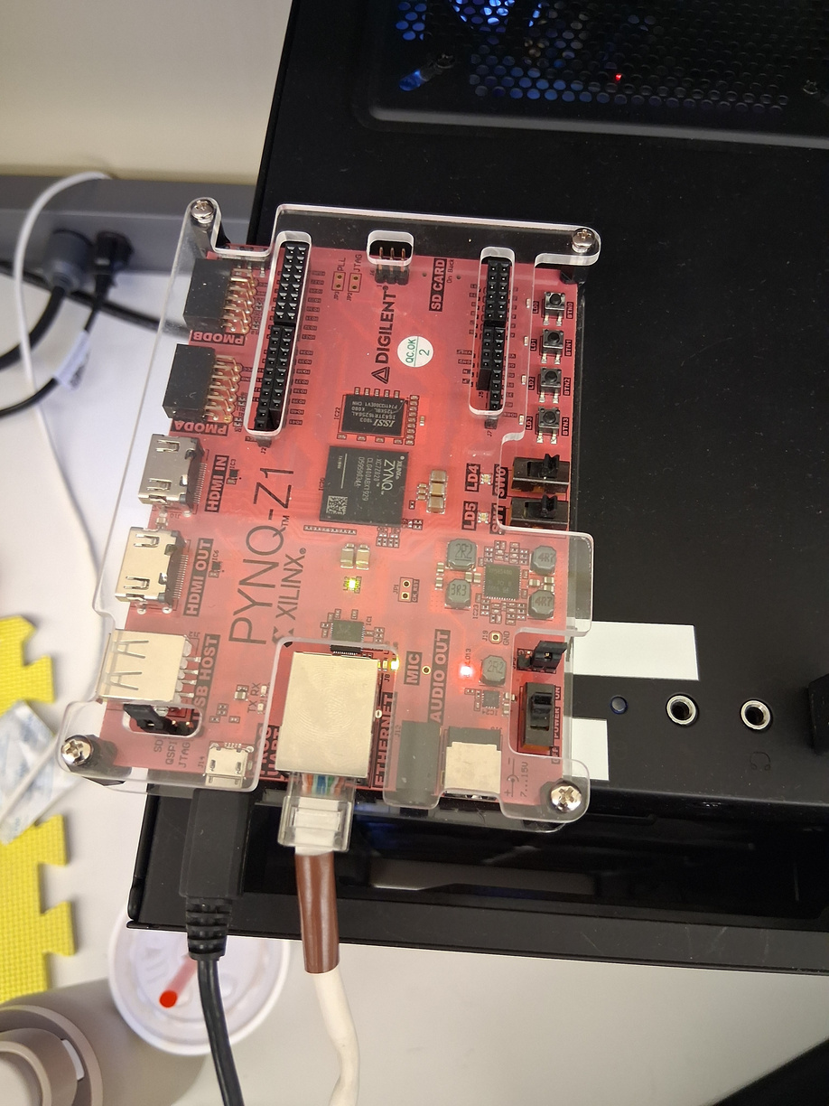
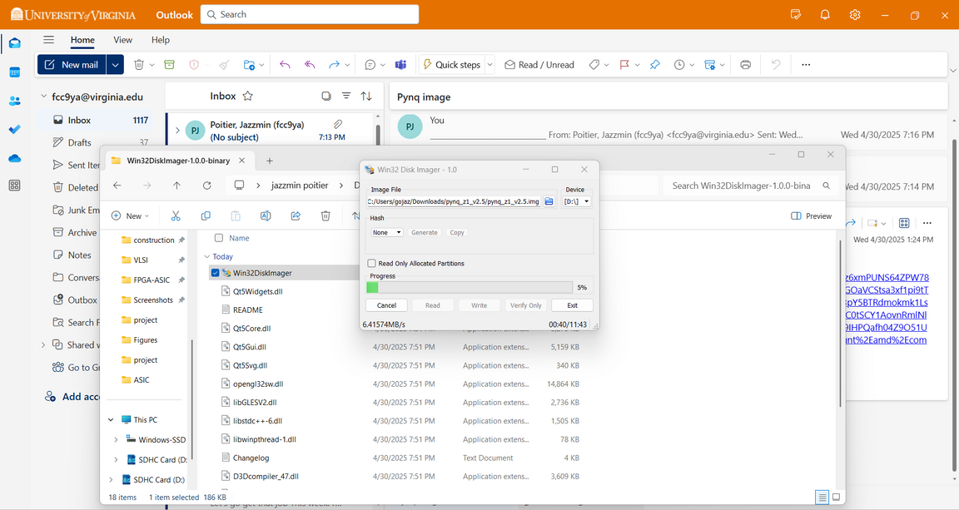
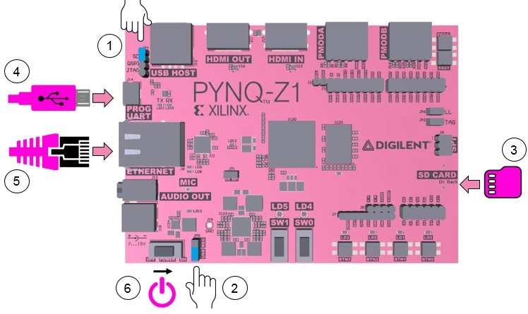
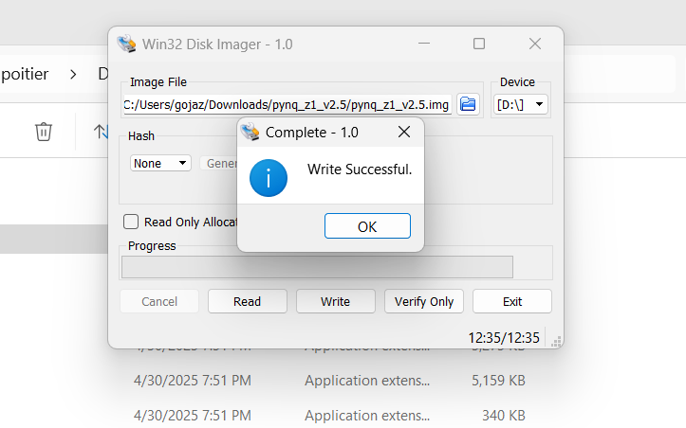
Architecture Selection and Data Preparation
Installed PYNQ v2.5 image on the board’s SD card(
Connected the board to PC, retrieved IP address, and accessed the Jupyter interface
5
Notes:
We connected the PYNQ-Z1 board to our PC and retrieved its IP address to access it via a web browser.
We installed a fresh PYNQ v2.5 image on the SD card to ensure compatibility with the tutorial and overlays.
Open-source project from AMD
A PYNQ image in FPGA design is an open-source project that allows designers to use the Python language and libraries to exploit the benefits of programmable logic and micro-processors on AMD platforms. We installated the bootable prebuilt image version 2.5 In order to correct the missing library bnn.h error that we were encountering while runing the project .
We connected the board and access the online jupyter notebook on the board as shown in the picture

Slide 6
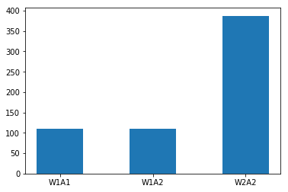
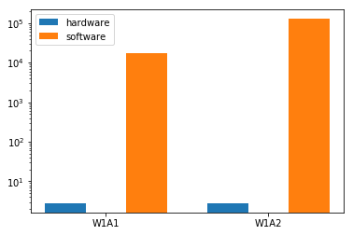
Architecture Selection and Data Preparation
Ran BNN notebook examples on our Pynq board to evaluate built-in neural networks peformance for the hardware and software classifier
Selected the best-performing model for lung cancer classification
Comparaison of hardware execution time of the CNV trained on cifar 10 test set
Comparaison of hardware execution time of the LFC trained on cifar 10 test set
Accuracy result : hardware W1A1: 79.22%
W1A2 : 82.66%
W2A2: 84.29%
Accuracy and best inference time result : software 700s W2A2: 79.22%
Best Accuracy result :
hardware W2A2: 98.4%
Software W2A2 : ~90%
6
Notes:
Once our development environment was set up and the board was running PYNQ v2.5, the next major step was to evaluate which neural network architecture would be best suited for our lung cancer classification task. The BNN-PYNQ framework comes with two primary overlay types: CNV, which is a convolutional network designed for RGB images sized 32 by 32, and LFC, which is a fully connected network typically used for grayscale images sized 28 by 28.
We started by running several prebuilt tutorials provided in the BNN-PYNQ repository to test both overlays—CNV and LFC—on the provided CIFAR-10 dataset. Our objective was to compare both hardware and software executions based on two key metrics: classification accuracy and inference time.
For the CNV overlay, we evaluated different quantization modes including W1A1, W1A2, and W2A2. The best result on hardware was about 84.29% accuracy with W2A2, while the software equivalent achieved similar performance but took significantly longer—in our test, the inference time was around 700 seconds for the full batch.
For the LFC overlay, we saw even higher accuracy on the CIFAR dataset, with the hardware W2A2 configuration reaching 98.4%, and the software classifier scoring around 90%. However, since LFC is optimized for grayscale and our lung cancer images are in RGB, the CNV structure was more aligned with our data format.
After comparing both options, we decided to proceed with the CNV architecture, as it offered a good trade-off between accuracy, speed, and compatibility with our dataset format. This selection set the foundation for the next step—adapting our Kaggle lung cancer dataset for FPGA-based classification.

Slide 7
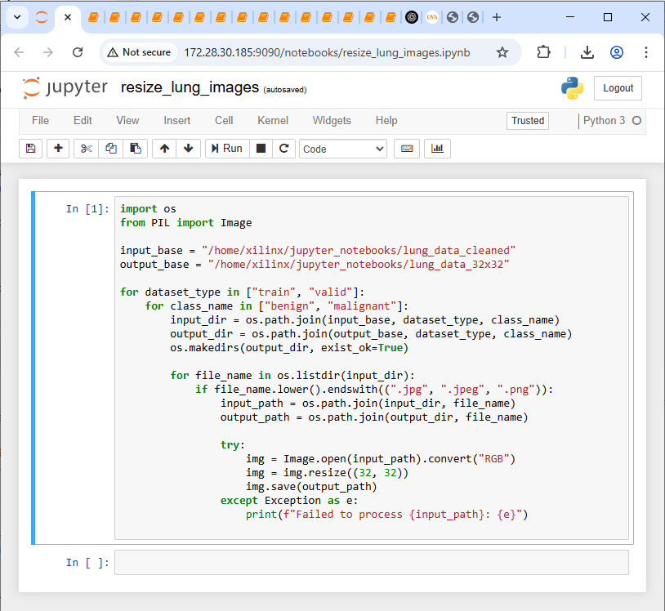
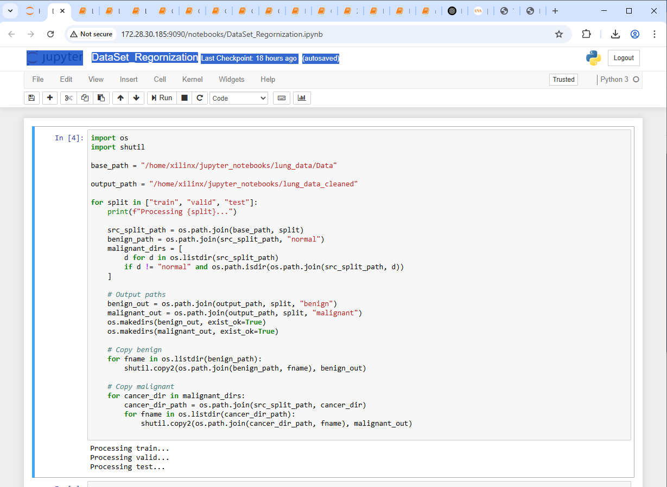
Architecture Selection and Data Preparation
Dataset Preparation:
Downloaded lung cancer dataset from Kaggle
Wrote Python scripts to:
Reorganize images into two classes: Benign and Malignant & Resize images to 32×32 for compatibility with the board
7
Notes:
Our dataset was downloaded from Kaggle and required preprocessing before it could be used with the BNN overlay.
The preprocessing included:
Writing Python scripts to reorganize the dataset into two labeled classes: benign and malignant.
Resizing all image data to compatible dimensions (32x32), to facilitate smoother integration with the FPGA overlay and ensure uniformity in training and inference.

Slide 8
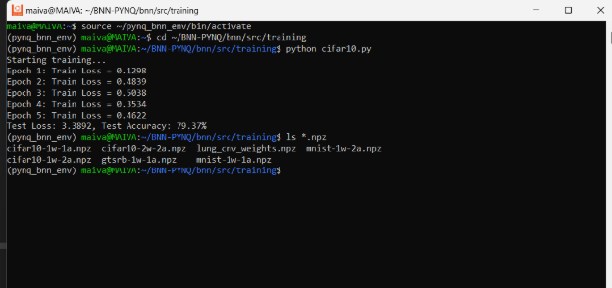
Model Training and Deployment
step 1: Trained model using lung_cancer.py (Python 2.7 virtual environment)
Step 2: Generated .npz model files with training parameters
8
Notes:
To begin the hardware acceleration phase of our lung cancer classification project, I worked within the BNN-PYNQ repository, which provides pre-built binaries and scripts for deploying quantized neural networks on the PYNQ Z1 board.
The first step involved adapting the existing cifar10.py file. Originally, this script is tailored for classifying images from the CIFAR-10 dataset. However, since my project focuses on binary classification—distinguishing between benign and malignant lung cancer—I modified this script to handle two classes instead of ten. I updated the preprocessing pipeline to resize our medical images to 32x32 pixels, which is required for compatibility with the underlying BNN architecture.
I ran the modified script using the command:
nginx
CopyEdit
python cifar10.py
This command executed the quantized training or inference process, depending on how I configured the script. It leverages Theano and FINN-style BNN layers to generate intermediate feature outputs in a format optimized for deployment on the FPGA.
While running the code, I used:
bash
CopyEdit
ls *rz
to inspect the directory and confirm that the .npz file was generated. This .npz file is a compressed NumPy archive containing the trained network parameters, such as weights and biases. These are crucial because they are later used by the bitstream generation and inference engine on the PYNQ board.
Why is this important? Because this compressed file bridges the training environment and the FPGA runtime. Without it, the model could not be ported or run on the actual board. This step completes the software preparation phase and ensures our custom classifier is ready for hardware execution."

Slide 9
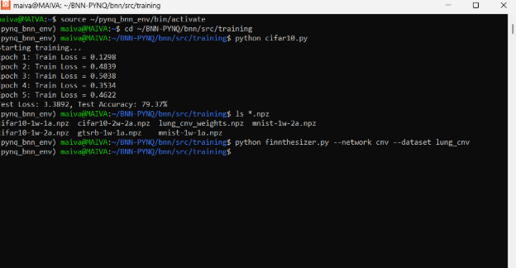
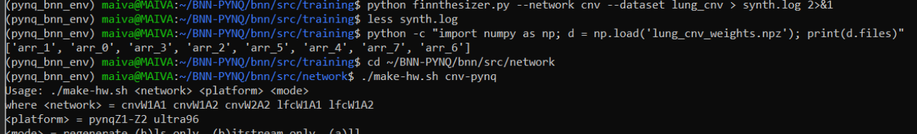
Model Training and Deployment
Step 4: Convert to Binary Format for PYNQ (Using FINNthesizer)
9
Notes:
However, these .npz files are not directly usable by the FPGA overlay. To bridge this gap, we used a tool called FINNthesizer, provided within the same framework. FINNthesizer is responsible for converting the high-level model into a low-level representation that the hardware overlay can understand.
We ran the FINNthesizer script with the following command:
css
CopyEdit
python finnthesizer.py --network cnv --dataset lung_cancer
This command took our .npz weights and generated all the necessary hardware-ready binary files, including configuration headers and quantized parameters. These files are essential for loading custom models into the CNV overlay on the PYNQ board.
“After successfully converting our trained model into binary format using FINNthesizer, we moved to the final and most crucial step of the hardware implementation: generating the FPGA bitstream. This step is required to configure the programmable logic on the PYNQ-Z1 board so that it can execute our custom-trained BNN model.
To perform this, the make-hw script provided by the BNN-PYNQ framework must call Vivado High-Level Synthesis, also known as Vivado HLS. Vivado is the software tool from Xilinx that translates C++ or HLS-compatible models into synthesizable Verilog or VHDL and eventually into a bitstream (.bit file) that configures the FPGA hardware.
However, when we initially ran the hardware generation command:
css
CopyEdit
make-hw cnv-pynq pynqZ1-Z2 all
we encountered an error related to Vivado itself. The installed version was incompatible with the BNN-PYNQ framework. BNN-PYNQ is specifically designed to work with Vivado 2018.2, so I reinstalled that exact version and made sure Vivado HLS was correctly enabled and sourced in the environment.
Unfortunately, after resolving the version issue, we encountered another roadblock. The build process failed again—this time due to a missing file: library.h. This file is a core dependency used in the hardware description and build pipeline. It contains essential function declarations and macros that are required for compiling the custom overlay logic. Without it, Vivado HLS cannot complete the synthesis step, and as a result, the bitstream cannot be generated.
In FPGA workflows, missing header files like library.h usually indicate an incomplete or corrupted repository, a misconfigured environment, or a failed dependency during installation. In our case, despite multiple attempts to locate or regenerate the file, we were unable to recover it. As a result, we could not complete the bitstream generation and were ultimately blocked from finalizing hardware deployment.
This was a major setback, but it revealed a lot about the fragility and strict requirements of FPGA-based toolchains. It also emphasized the importance of version control, complete dependency management, and toolchain compatibility when working in embedded AI development.”

Slide 10
Reflection – Lessons Learned & Challenges Faced
What to Do ✅
Use BNN-PYNQ overlays for quick FPGA prototyping.
Stick to officially supported tool versions:
Python 2.7 for legacy BNN scripts
Vivado 2018.2 HLS for hardware compilation
Always verify .so libraries exist after setup.
Follow established workflows (e.g., FINNthesizer pipeline) before customizing.
Document each step and error for efficient debugging.
What Not to Do ❌
Avoid mixing Vivado versions; stick to the one known to work (2018.2).
Don't assume overlays contain expected IP blocks—always inspect .bit file contents.
Never skip testing with precompiled examples before deploying custom data.
Don't use unsupported Python versions (e.g., 3.6+) unless fully compatible.
Key Debugging Challenges
Missing .so files: road-signs-cnv-pynq.so, libbnn.so
Syntax & overlay errors: incorrect path usage, missing load_parameters
Bitstream issues: make-hw failed due to missing Vivado HLS or libraries
Jupyter folder mismatches and precompiled binaries missing
10

Slide 11
Thank You
Conclusion
Successfully trained a CNN-based lung cancer classifier with >70% accuracy in software (Python, PyTorch)
Preprocessed and resized medical images for FPGA compatibility
Converted trained model using FINNthesizer pipeline
Deployed model files to PYNQ-Z1 board and integrated into the BNN folder
Current Limitation
Unable to complete hardware execution phase due to:
Vivado installation issues (only 2018.2 HLS compatible)
make-hw failures and missing .so files
Bitstream overlay not exposing required IPs
Shared object libraries not generated despite extensive debugging
Future Improvements
Rebuild hardware overlays with confirmed IP compatibility
Use a containerized environment to lock working versions of Vivado, Python, and BNN
Explore precompiled overlays or port to Ultra96 if Z1 limitations persist
11

